Slide 1

AEROSAFE
Arduino Based Gas Leakage and Ventilation System
TEAM MEMBERS: AKASH VERGHESE PAUL AGNA ANTONY
ADNAN BASHEER P GAYATHRI M
HIMA MARIYAM KURIEN

Slide 2

INTRODUCTION
Gas leakage is a serious safety issue in homes and industries.
Arduino is used as the main controller for sensor monitoring. MQ5 sensor detects gas leakage in the environment.
DHT11 sensor measures temperature. PIR sensor detects human movement.
LDR sensor measures surrounding light intensity.
When gas leakage is detected, ventilation action is activated. The project is low-cost, simple, and easy to implement.

Slide 3
ABSTRACT
The proposed system is designed to enhance safety by detecting hazardous gas leaks and monitoring environmental
conditions in real time.
The System is designed to detect gas leakage and monitor environmental conditions using different sensors. The system uses an MQ5 sensor to detect gas leakage, a DHT11 sensor to measure temperature, a PIR sensor to detect human movement, and an LDR sensor to detect light intensity.
When gas leakage is detected, the Arduino activates the ventilation process to improve safety. The system continuously monitors the surroundings and helps provide a safer indoor environment. This project is simple, low cost, and suitable for homes and small industries.

Slide 4

INDEX
INTRODUCTION
ABSTRACT
ACKNOWLEDGEMENT
PROBLEM STATEMENT
OBJECTIVE
SYSTEM ARCHITECTURE
COMPONENTS USED
WORKING PRINCIPLE
ADVANTAGES & APPLICATIONS
FURTURE SCOPE & CONCLUSION

Slide 5
ACKNOWLEDGMENT
We sincerely thank our project guide, department staff, and institution for their valuable support and guidance
throughout the completion of this mini project.
We also thank our teammates for their cooperation and teamwork in developing the “Arduino Based Gas Leakage and Ventilation System”.
Finally, we express our gratitude to everyone who helped directly and indirectly in completing this project successfully.

Slide 6
PROBLEM STATEMENT
Gas leakage can cause serious safety hazards, fires, and health risks.
Existing systems often rely on manual monitoring and delayed response. Lack of continuous environmental monitoring reduces overall safety.
A low-cost automated system is needed to detect gas leaks and activate ventilation promptly.

Slide 7
OBJECTIVES
Detect gas leakage using MQ5 sensor
Monitor temperature using DHT11
Detect human movement using PIR sensor Detect whether it is day or night using LDR Low-cost and easy-to-implement safety system Suitable for homes and small industries

Slide 8
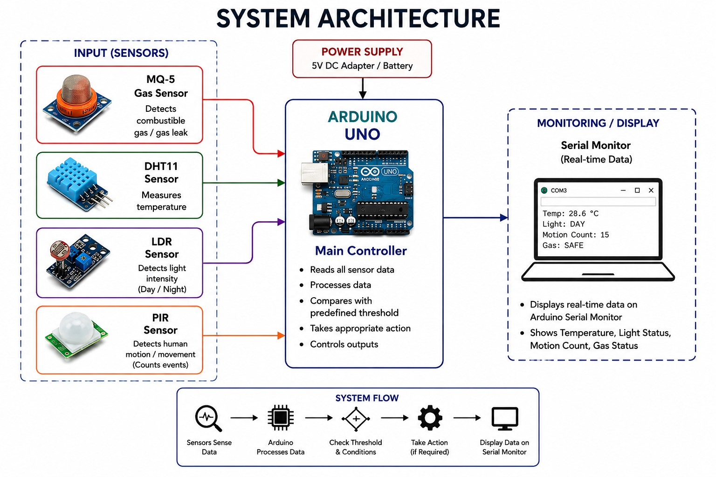

Slide 9

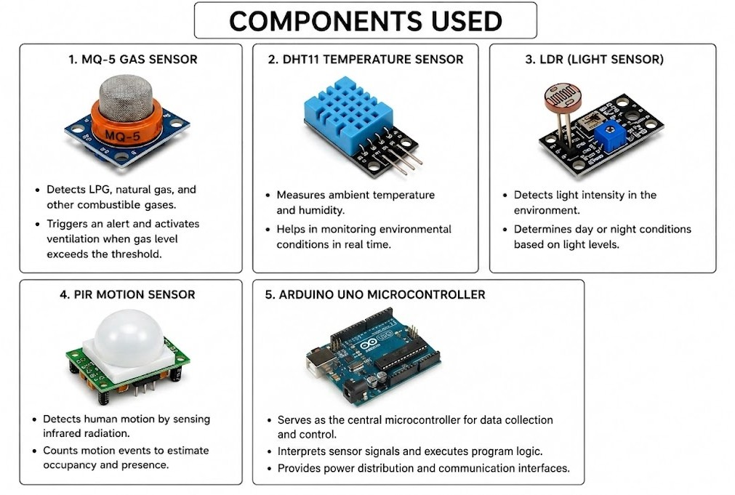

Slide 10
WORKING PRINCIPLE
The MQ5 sensor continuously monitors the environment for gas leakage.
The DHT11 sensor measures temperature and humidity levels. The PIR sensor detects human movement near the system.
The LDR sensor detects the surrounding light intensity. All sensor data is sent to the Arduino controller.
The Arduino processes the received sensor values.
If gas leakage is detected above the set limit, the system activates the ventilation process automatically. The system continues monitoring until the gas level becomes normal.
The entire process works automatically without human intervention.

Slide 11
ADVANTAGES
Detects gas leakage in real time and automatically activates ventilation Low Cost and Easy Implementation
Automatic Environmental Monitoring – Continuously monitors gas levels, temperature, light intensity, and human movement without requiring human intervention.
APPLICATIONS
Homes and kitchens Laboratories
Small industries and factories

Slide 12
CONCLUSION & FUTURE SCOPE
Multi-level ventilation based on gas concentration.
GSM/Wi-Fi alerts for remote monitoring.
AI-based anomaly detection for fewer false alarms. Multi-gas monitoring using additional sensors.
Smart gas leakage detection using MQ-5 sensor.
Real-time monitoring of temperature, light, and motion. Automatic ventilation during gas leakage.
Low-cost and effective safety solution.

Slide 13
THANK YOU

